Slide 1
Day 6
15-11-2021
Core-java

Slide 2
Objectives
Enum
Annotation in Java
Inner Classes
Log4j

Slide 3
Enum
The Enum in Java is a data type which contains a fixed set of constants
It can be used for days of the week (SUNDAY, MONDAY, TUESDAY, WEDNESDAY, THURSDAY, FRIDAY, and SATURDAY) , directions (NORTH, SOUTH, EAST, and WEST), season (SPRING, SUMMER, WINTER, and AUTUMN or FALL), colors (RED, YELLOW, BLUE, GREEN, WHITE, and BLACK) etc. According to the Java naming conventions, we should have all constants in capital letters. So, we have enum constants in capital letters.

Slide 4
Enum
Enum improves type safety
Enum can be easily used in switch
Enum can be traversed
Enum can have fields, constructors and methods
Enum may implement many interfaces but cannot extend any class because it internally extends Enum class

Slide 5
Enum
Defining Java Enum
The enum can be defined within or outside the class because it is similar to a class. The semicolon (;) at the end of the enum constants are optional.
  enum Season { WINTER, SPRING, SUMMER, FALL }
  enum Season { WINTER, SPRING, SUMMER, FALL; }
  enum Season{ WINTER(5), SPRING(10), SUMMER(15), FALL(20);

Slide 6
Enum
  Can we create the instance of Enum by new keyword?
    No, because it contains private constructors only.
  Can we have an abstract method in the Enum?
    Yes, Of course! we can have abstract methods and can provide the implementation of these methods.
    Java Enum in a switch statement
    We can apply enum on switch statement.

Slide 7
Annotations
Java Annotation is a tag that represents the metadata i.e. attached with class, interface, methods or fields to indicate some additional information which can be used by java compiler and JVM.
Annotations in Java are used to provide additional information, so it is an alternative option for XML and Java marker interfaces.

Slide 8
Annotations
Built-In Java Annotations used in Java code
  @Override
  @SuppressWarnings
  @Deprecated
Built-In Java Annotations used in other annotations
  @Target
  @Retention
  @Inherited
  @Documented

Slide 9
Annotations
@Override
@Override annotation assures that the subclass method is overriding the parent class method. If it is not so, compile time error occurs.
@SuppressWarnings
@SuppressWarnings annotation: is used to suppress warnings issued by the compiler.
@Deprecated
@Deprecated annoation marks that this method is deprecated so compiler prints warning. It informs user that it may be removed in the future versions.

Slide 10
Annotations
@Target
@Target tag is used to specify at which type, the annotation is used
The java.lang.annotation.ElementType enum declares many constants to specify the type of element where annotation is to be applied such as TYPE, METHOD, FIELD etc. Let's see the constants of ElementType enum:
Element Types | Where the annotation can be applied
TYPE | class, interface or enumeration
FIELD | fields
METHOD | methods
CONSTRUCTOR | constructors
LOCAL_VARIABLE | local variables
ANNOTATION_TYPE | annotation type
PARAMETER | parameter

Slide 11
Annotations
@Retention
@Retention annotation is used to specify to what level annotation will be available.
RetentionPolicy | Availability
RetentionPolicy.SOURCE | refers to the source code, discarded during compilation. It will not be available in the compiled class.
RetentionPolicy.CLASS | refers to the .class file, available to java compiler but not to JVM . It is included in the class file.
RetentionPolicy.RUNTIME | refers to the runtime, available to java compiler and JVM .

Slide 12
Annotations
@Inherited
By default, annotations are not inherited to subclasses. The @Inherited annotation marks the annotation to be inherited to subclasses.
Example
    @Inherited
    @interface ForEveryone { }//Now it will be available to subclass also
    @interface ForEveryone { }
    class Superclass{}
    class Subclass extends Superclass{}

Slide 13
Annotation
@Documented
The @Documented Marks the annotation for inclusion in the documentation.
@FunctionalInterface
This annotation introduced in Java 8. To specify any interface as Functional Interface.

Slide 14
Annotation
Custom Annotation
We have to follow steps for custom annotations are
  creating, applying and accessing annotation

Slide 15
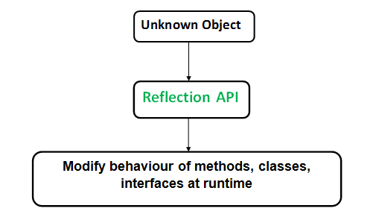
Reflection in Java
Reflection is an API which is used to examine or modify the behavior of methods, classes, interfaces at runtime.
The required classes for reflection are provided under java.lang.reflect package.
Reflection gives us information about the class to which an object belongs and also the methods of that class which can be executed by using the object.
Through reflection we can invoke methods at runtime irrespective of the access specifier used with them.

Slide 16
Reflection in Java
Reflection can be used to get information about –
  Class The getClass() method is used to get the name of the class to which an object belongs.
  Constructors The getConstructors() method is used to get the public constructors of the class to which an object belongs.
  Methods The getMethods() method is used to get the public methods of the class to which an objects belongs.

Slide 17
Nested classes
In Java, it is possible to define a class within another class, such classes are known as nested classes. They enable you to logically group classes that are only used in one place, thus this increases the use of encapsulation, and creates more readable and maintainable code.
The scope of a nested class is bounded by the scope of its enclosing class.
A nested class has access to the members, including private members, of the class in which it is nested.
A nested class is also a member of its enclosing class.
Nested classes are divided into two categories:
  static nested class : Nested classes that are declared static are called static nested classes.
  inner class : An inner class is a non-static nested class.

Slide 18
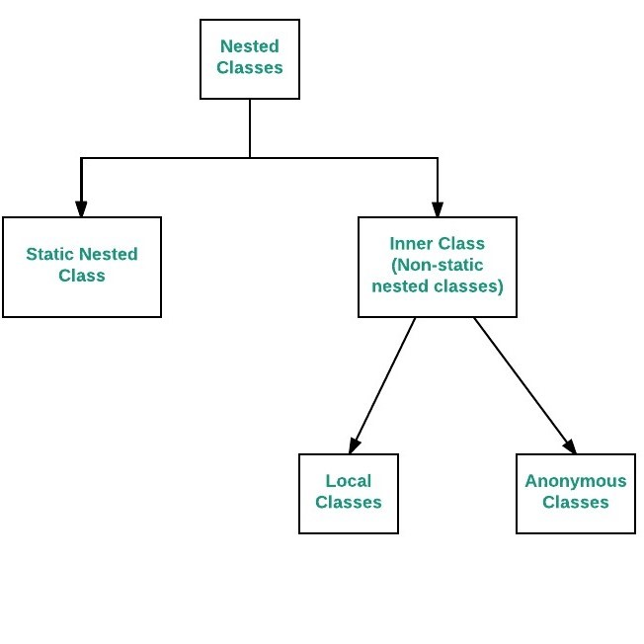
Nested classes
    Syntax :-
    class OuterClass
    {
    ...
    class NestedClass
    {
    ...
    }
    }

Slide 19
Static Nested Class
In the case of normal or regular inner classes, without an outer class object existing, there cannot be an inner class object. i.e., an object of the inner class is always strongly associated with an outer class object. But in the case of static nested class, Without an outer class object existing, there may be a static nested class object. i.e., an object of a static nested class is not strongly associated with the outer class object.

Slide 20
Inner Class
To instantiate an inner class, you must first instantiate the outer class. Then, create the inner object within the outer object with this syntax:
OuterClass.InnerClass innerObject = outerObject.new InnerClass();

Slide 21
Static Nested Vs Inner Class
S.NO | Normal/Regular inner class | Static nested class
1. | Without an outer class object existing, there cannot be an inner class object. That is, the inner class object is always associated with the outer class object. | Without an outer class object existing, there may be a static nested class object. That is, static nested class object is not associated with the outer class object.
2. | Inside normal/regular inner class, static members can’t be declared. | Inside static nested class, static members can be declared.
3. | As main() method can’t be declared, regular inner class can’t be invoked directly from the command prompt. | As main() method can be declared, the static nested class can be invoked directly from the command prompt.
4. | Both static and non static members of outer class can be accessed directly. | Only a static member of outer class can be accessed directly.

Slide 22
Anonymous Inner Class in Java
It is an inner class without a name and for which only a single object is created. An anonymous inner class can be useful when making an instance of an object with certain “extras” such as overriding methods of a class or interface, without having to actually subclass a class.
// can be interface,abstract/concrete class
    Test t = new Test()
    {
    // data members and methods
    public void test_method()
    { ........ ........
    } };

Slide 23
Anonymous Inner Class in Java
Now let us do discuss the difference between regular class(normal classes) and Anonymous Inner class
A normal class can implement any number of interfaces but the anonymous inner class can implement only one interface at a time.
A regular class can extend a class and implement any number of interfaces simultaneously. But anonymous Inner class can extend a class or can implement an interface but not both at a time.
For regular/normal class, we can write any number of constructors but we can’t write any constructor for anonymous Inner class because the anonymous class does not have any name and while defining constructor class name and constructor name must be same.

